Slide 1
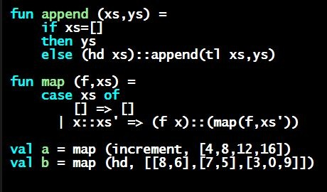
Programming Languages Dan Grossman University of Washington
Optional: Very High-Level Outline

Slide 2
Course Overview
Very hard to describe topics we haven’t done yet (!)
So don’t be intimidated and maybe skip this to “dive in”
Part A:
0. Software Installation
Basics, functions, recursion, scope, variables, tuples, lists, …
Give extra time for Section 1
Datatypes, pattern-matching, tail recursion
First-class functions, closures [and course motivation!]
Type inference, modules
Overall: A precisely specified introduction to functional programming built up piece-by-piece

Slide 3
Part B
Quick “re-do” in a dynamically typed language;
Delaying evaluation
Implementing languages with interpreters;
Static vs. dynamic typing

Slide 4
Part C
Dynamically-typed Object-Oriented Programming
OOP vs. Functional decomposition
Advanced OOP topics (e.g., mixins, double dispatch)
Generics vs. Subtyping
“Finishes the story” even if you “already know OOP”
Some with OOP background find 7 “less interesting” but stay tuned for 8
Some find Part C “anti-OOP”, which is mostly ☺ not true
About contrasting with what many “already think/know”
And yes, some focus on where commitment to “pure OOP” may be unwise even in “an OOP language”

